Slide 1
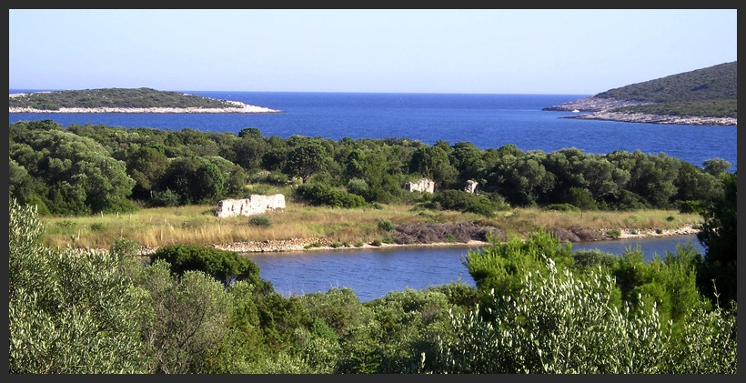
The Island of St. Klement, Croatia

Slide 2
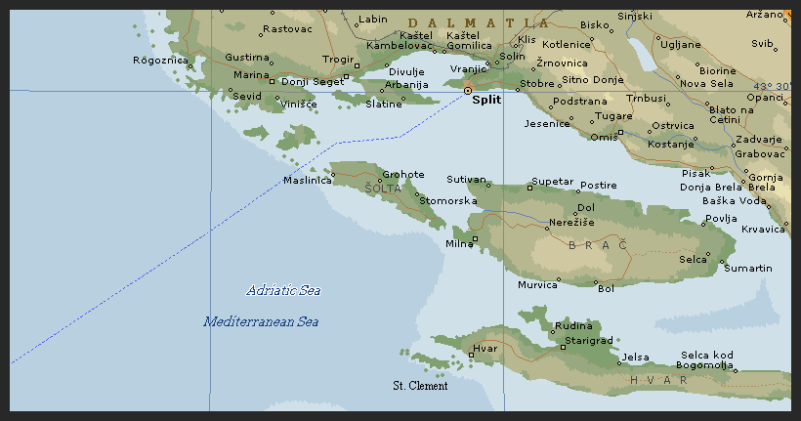
Purpose
Create a set of Maps for Dr. Vanca Schrunk which could be used for presentations, websites, or on site use.
Maps should include broad scope of Island as well as concentration on Soline Bay.
Not a large amount of data for the area

Slide 3
Data List
ESRI CNTRY 92
Google Earth
Pakleni Kanal Contour Map
Field Survey Map

Slide 4
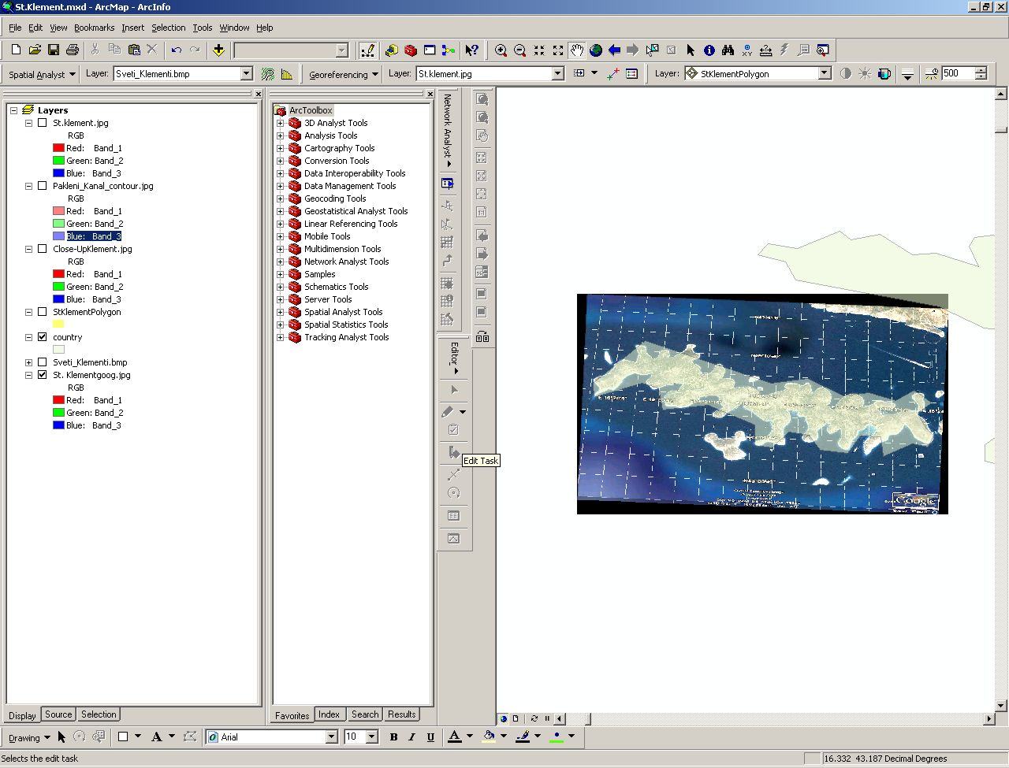
What has been done?

Slide 5
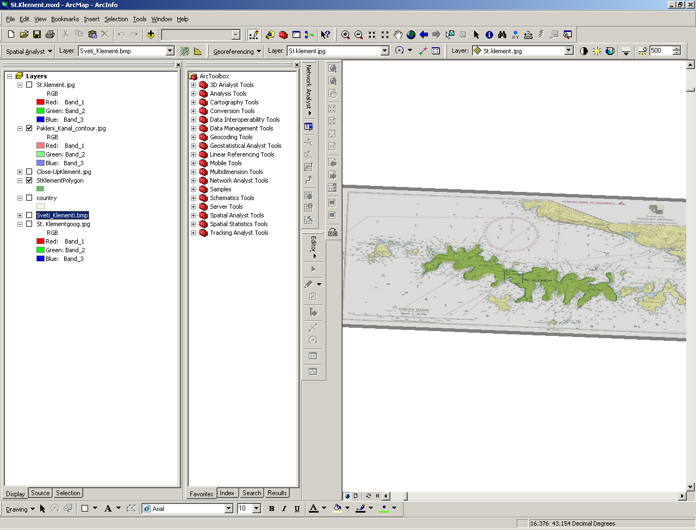

Slide 6
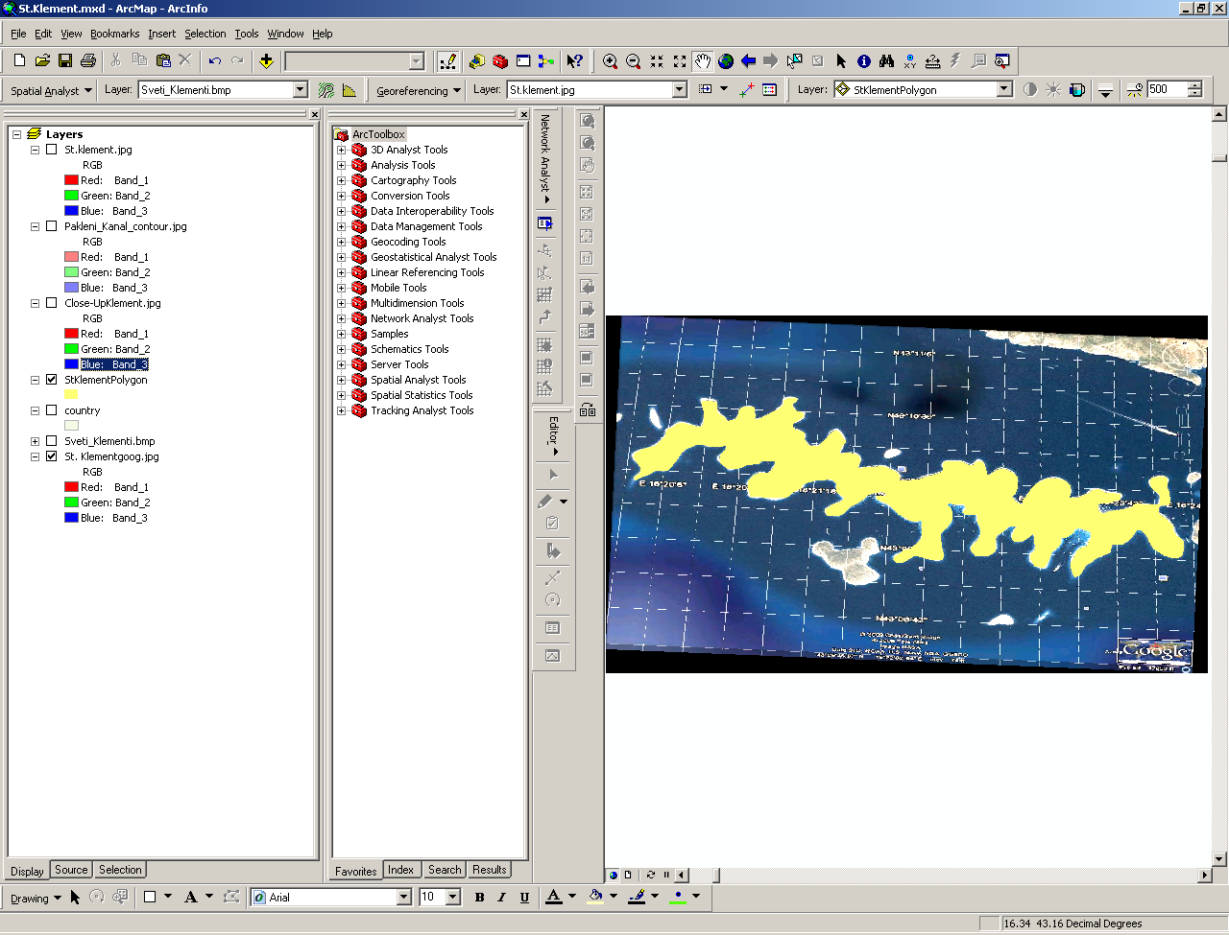

Slide 7
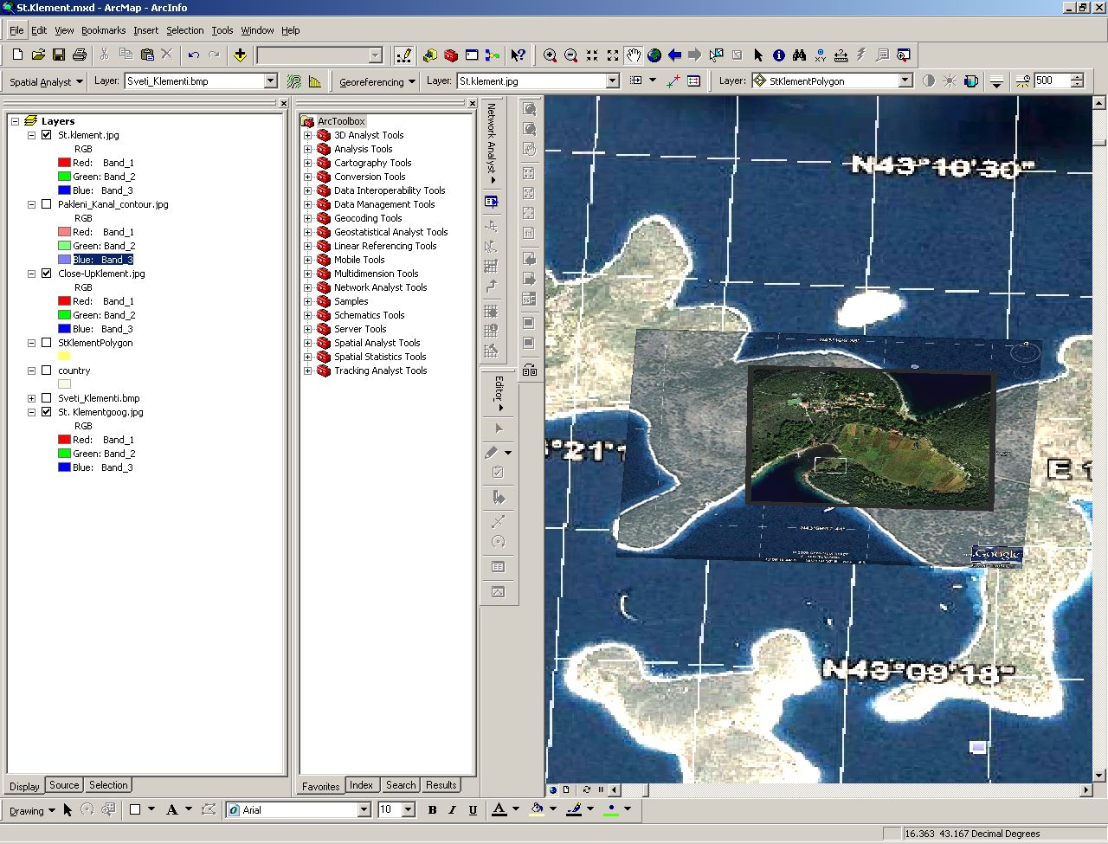

Slide 8
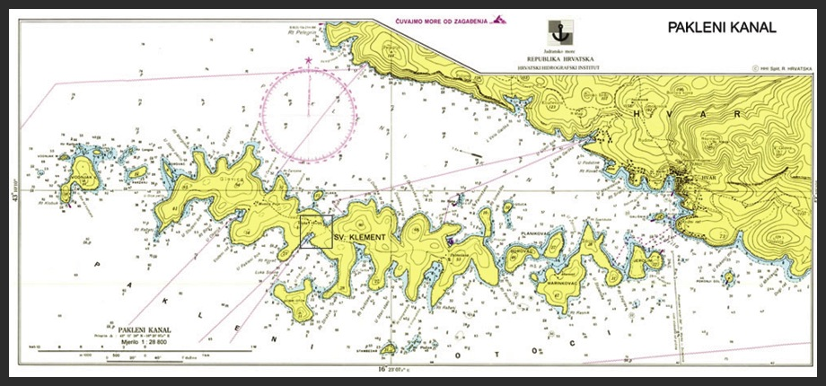
What’s Next?

Slide 9
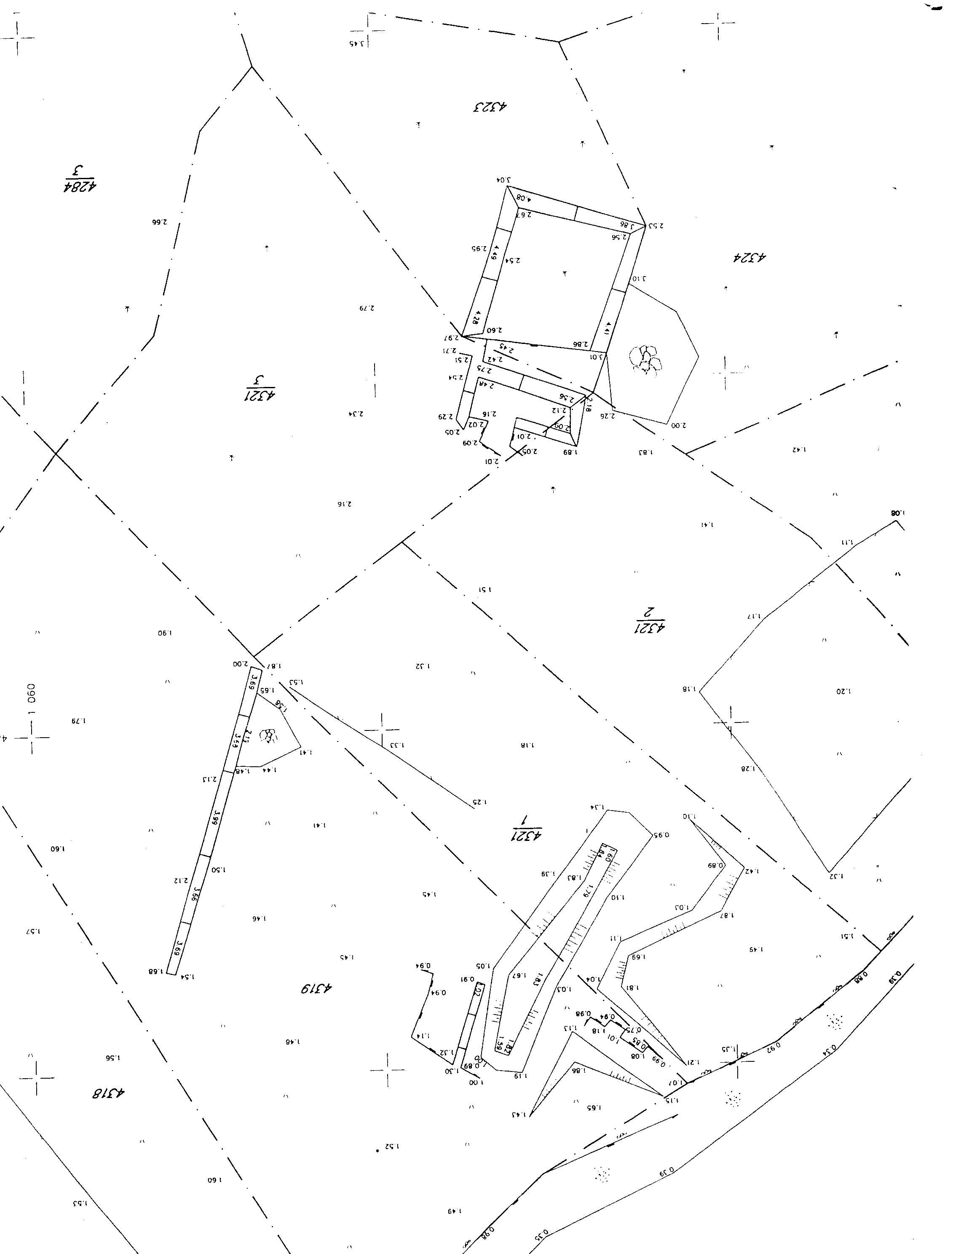
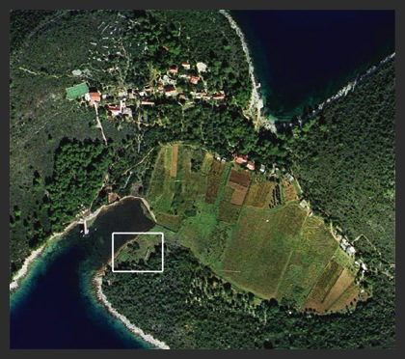

Slide 10
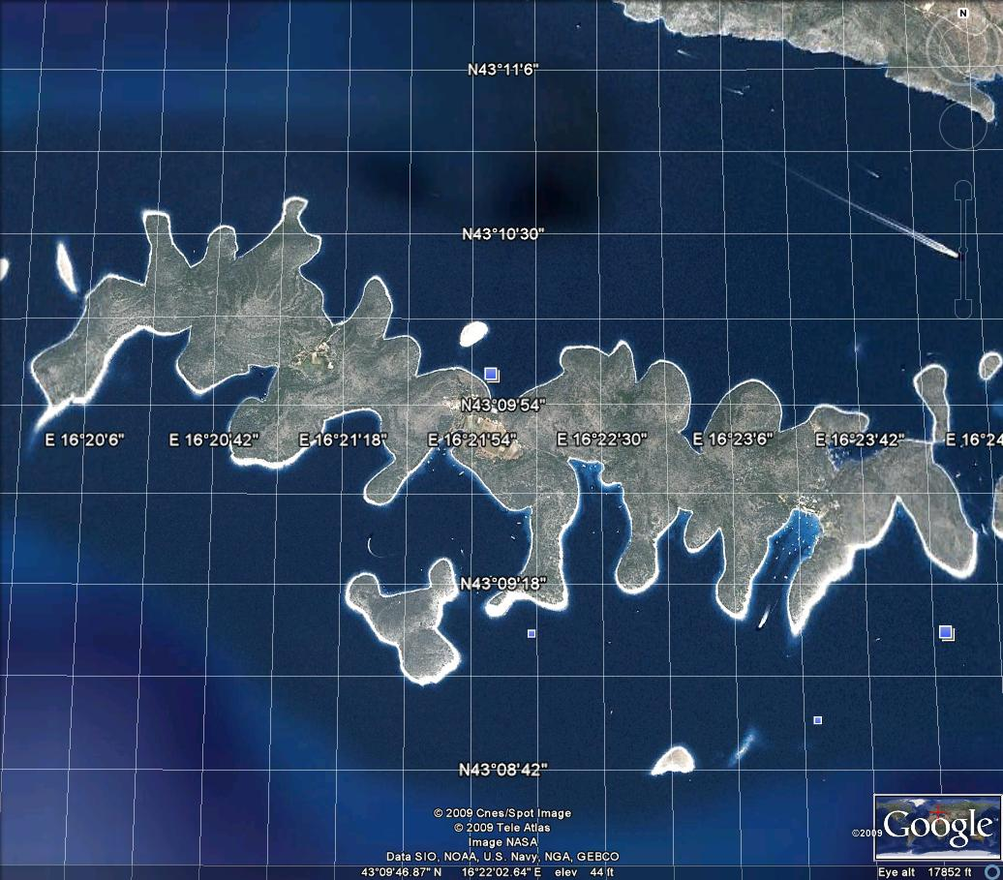

Slide 11
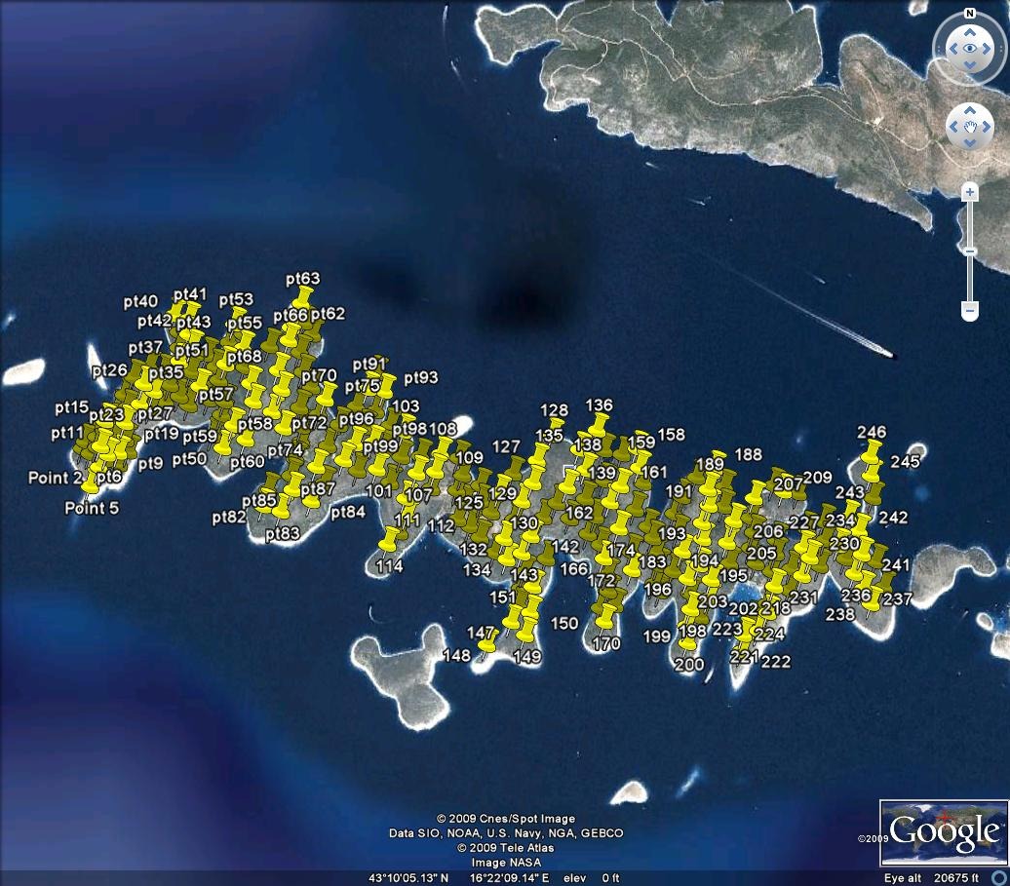
Elevation Data Collection Process

Slide 12
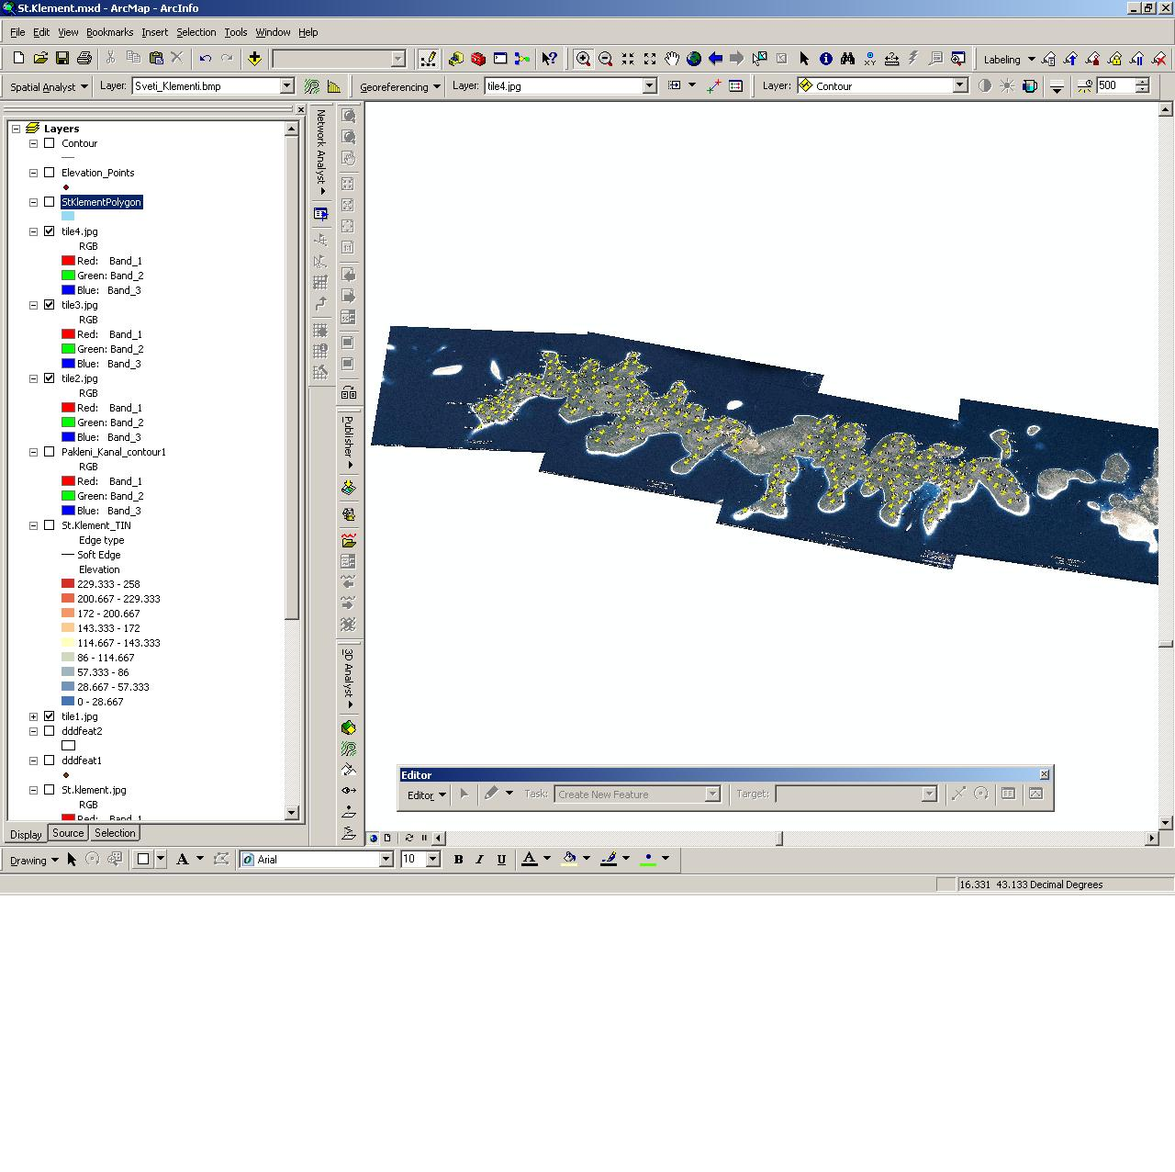
Georeferencing Tiles

Slide 13
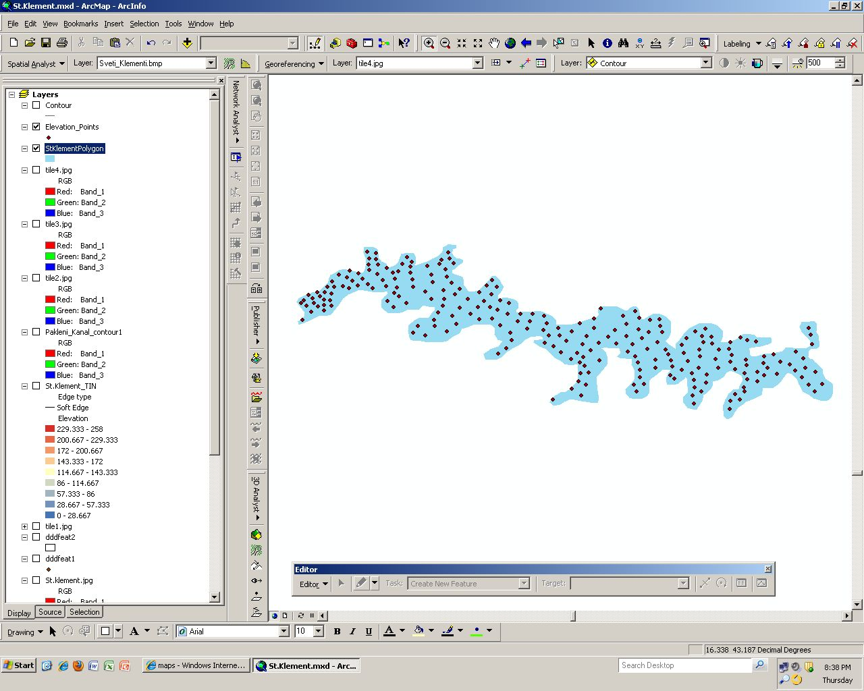

Slide 14
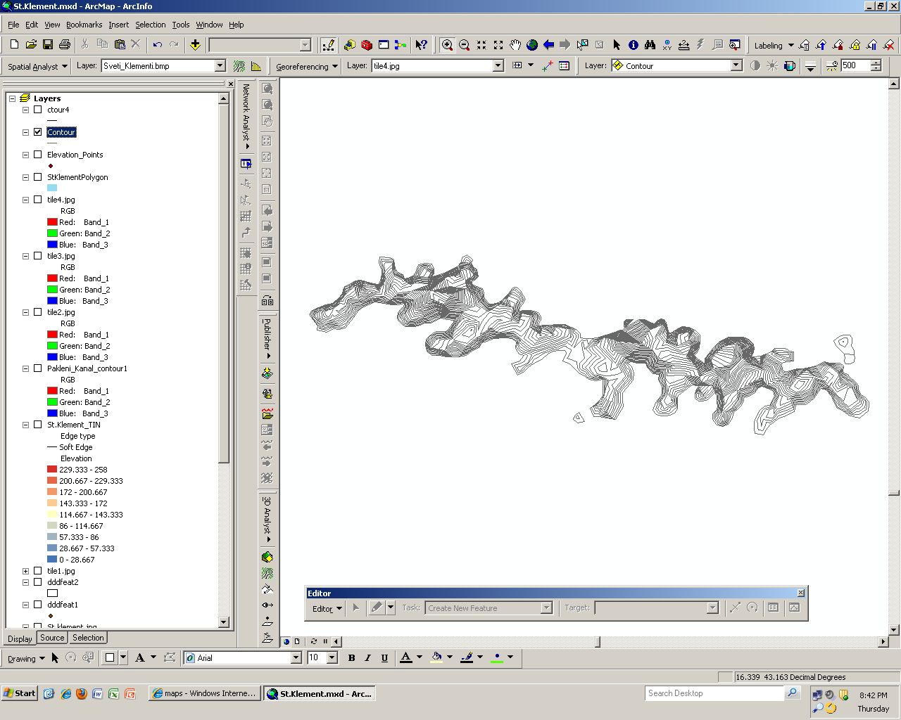

Slide 15
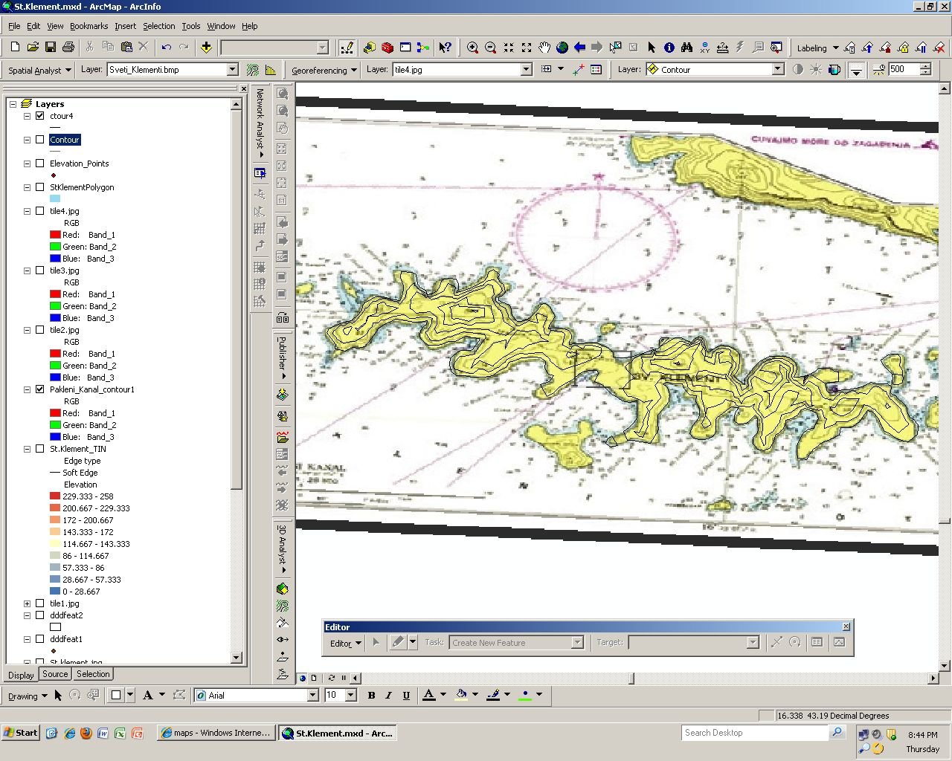

Slide 16
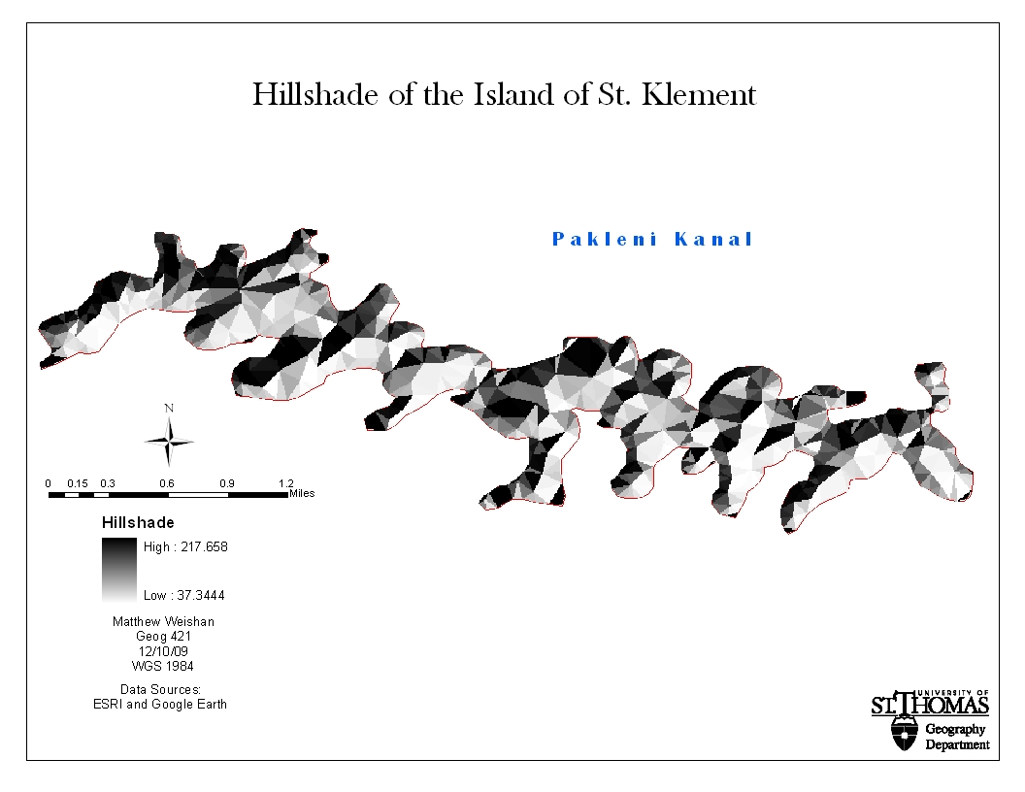

Slide 17
